Slide 1
QS World University Rankings 2025: Machine Learning Analysis and Prediction
Presented by Youssef Masoud, Arnav Kucheriya, and Kushagra Verma

Slide 2
Agenda
Dataset Overview
Data Cleaning and Preprocessing
Exploratory Data Analysis
Model Selection and Training
Model Evaluation and Visualizations
Feature Importance
Conclusions

Slide 3
Project Overview
Understand factors influencing university rankings
Predict Academic Reputation Scores using machine learning
Compare the performance of Linear Regression and Random Forest models
Identify key predictors for academic reputation

Slide 4
Dataset Overview
Source: QS World University Rankings 2025
27 Columns, 1,500+ Universities
Key Features: Reputation scores, research impact, faculty ratios

Slide 5
Dataset Details
Feature Types:
Categorical: Institution Name, Location
Numerical: Various score features (e.g., citations, employment outcomes)
Special Notes:
Missing values represented as '-'
Some features highly correlated with each other

Slide 6
Data Cleaning and Preprocessing
Convert score columns to numeric
Handle missing values
Label encode categorical features

Slide 7
Detailed Preprocessing
Missing Values:
~5% of records dropped due to incomplete data
Label Encoding:
Institution Name and Location turned into integers
Rationale:
Ensured clean numeric matrix input for modeling

Slide 8
Why Data Preprocessing Matters
Ensures model compatibility Improves accuracy
Improves accuracy
Reduces biases

Slide 9
Exploratory Data Analysis (EDA)
Understand patterns and relationships
Identify important variables
Guide feature selection

Slide 10
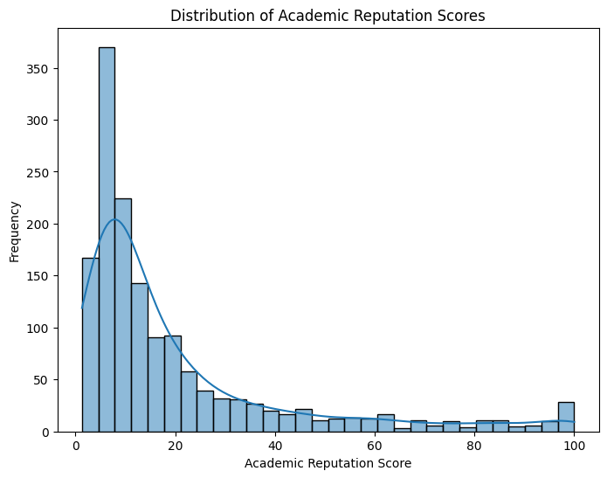

Slide 11
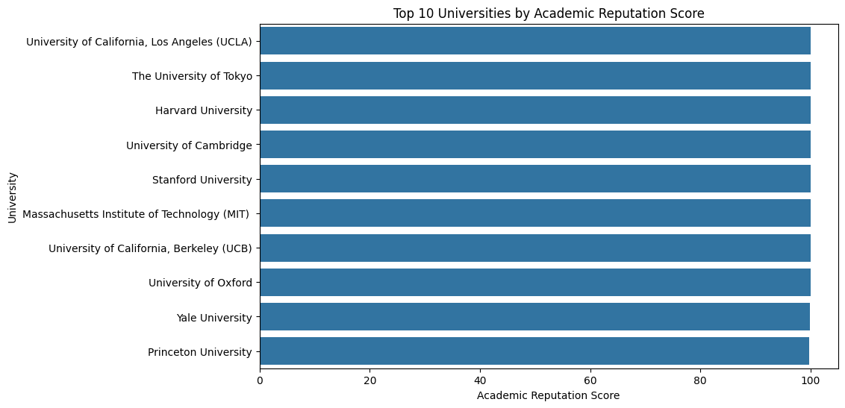

Slide 12
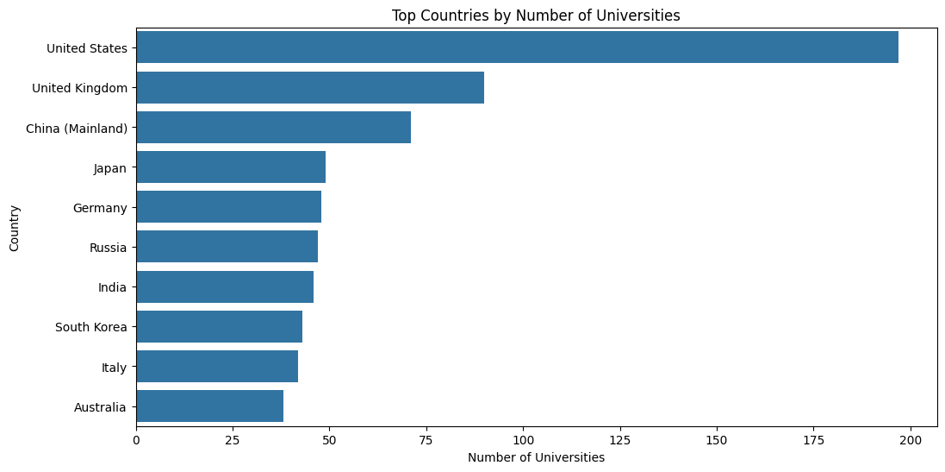

Slide 13
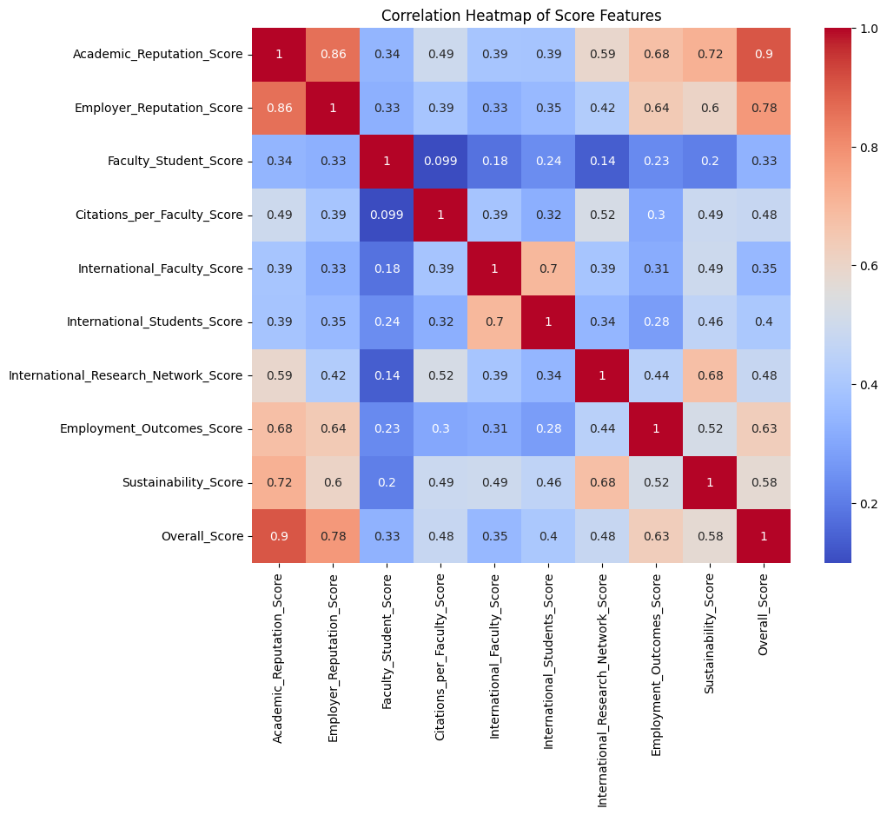

Slide 14
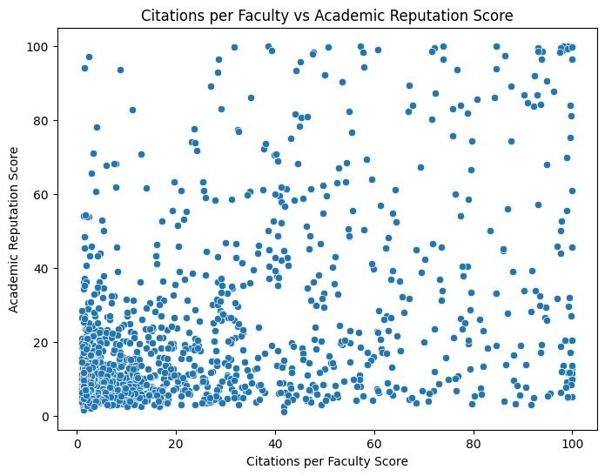

Slide 15
Model Training Summary
Linear Regression: Quick training, simple assumptions
Random Forest: Handles complexity, avoids overfitting
Purpose: Predict Academic Reputation Scores accurately

Slide 16

Training Code: Linear Regression

Slide 17

Training Code: Random Forest

Slide 18
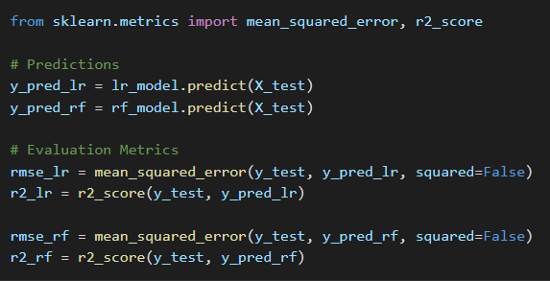
Model Evaluation Code

Slide 19
Model Performance Comparison
Linear Regression:
RMSE: 15.53
R² Score: 0.64
Random Forest:
RMSE: 14.80
R² Score: 0.67

Slide 20
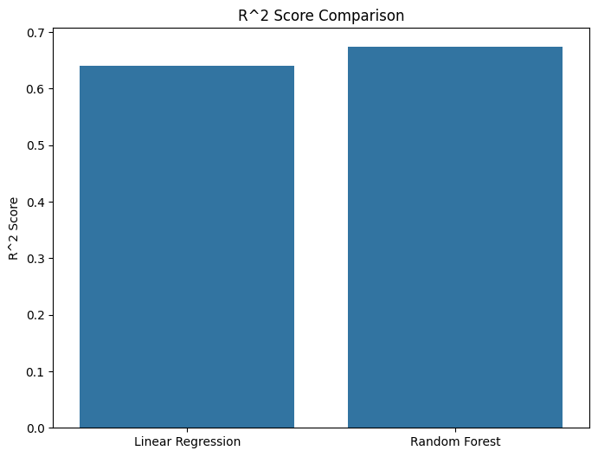
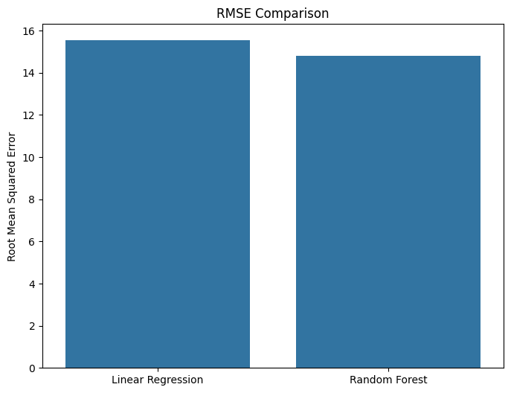
RMSE and R² Score Comparison

Slide 21
Why These Models?
Linear Regression:
Easy to interpret, good baseline
Random Forest:
Captures non-linearities, robust to overfitting
Comparison provides balanced insight

Slide 22
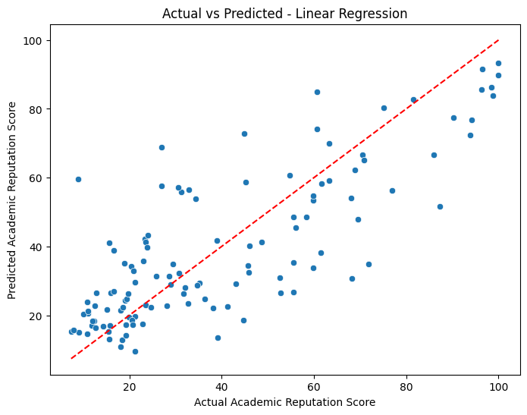

Slide 23
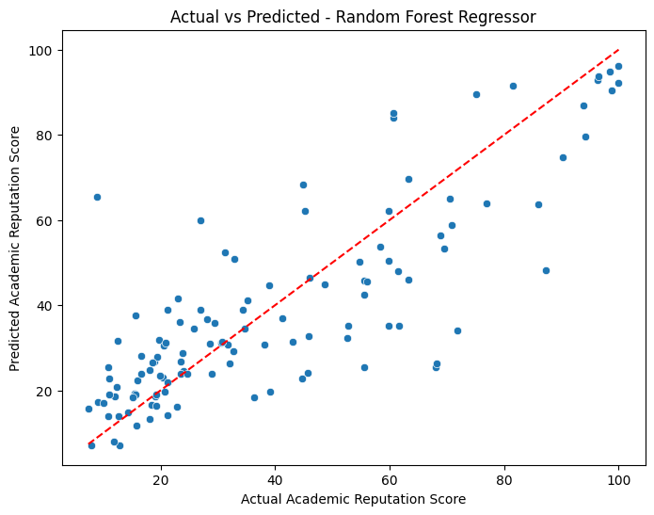

Slide 24
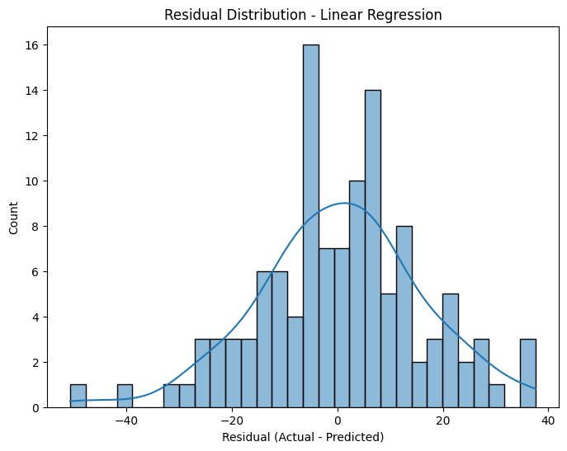

Slide 25
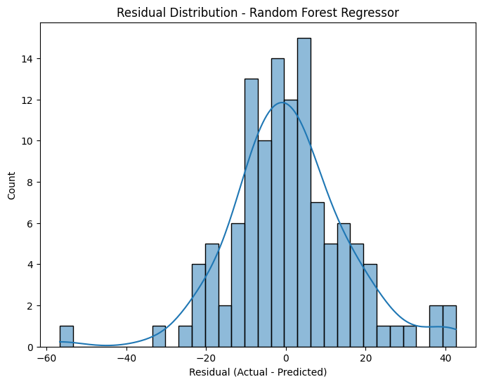

Slide 26
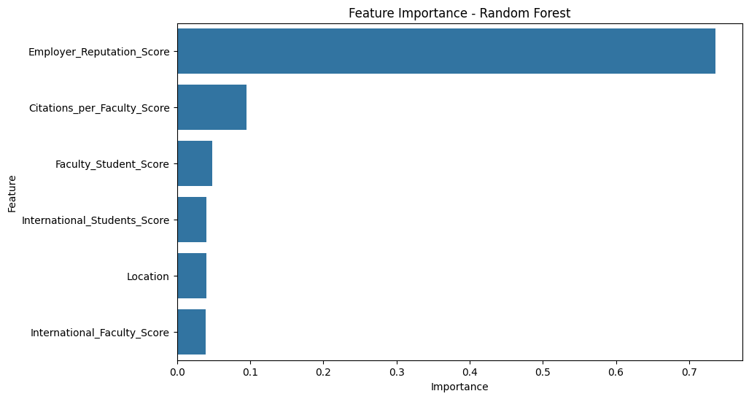

Slide 27
Key Insights
Research impact (citations) is a critical determinant of academic reputation.
Employer reputation plays a significant supporting role.
Random Forest captures hidden patterns better than linear models.
High-quality data preprocessing is crucial for model accuracy.
Institutional strategies should prioritize research output and industry engagement.

Slide 28
Challenges Faced
Data Issues:
Missing or corrupted entries
Inconsistent data formatting
Modeling Issues:
Linear Regression limited in capturing complex patterns
Mitigation:
Careful data cleaning, choosing an ensemble model

Slide 29
Conclusion
This project analyzed the QS World University Rankings 2025 dataset to predict Academic Reputation Scores based on institutional features. Through a structured machine learning workflow, several important insights emerged:
Random Forest outperformed Linear Regression
Focus on research and employer links
Machine learning provides strategic insights

Slide 30
Thank you

